Slide 1



Music Machine Learning
IX – Deep learning
Master ATIAM - Informatique
Philippe Esling (esling@ircam.fr)
Maître de conférences – UPMC
Equipe représentations musicales (IRCAM, Paris)

Slide 2
Going machine learning
As we have discussed earlier …
Artificial intelligence was set to simulate intelligence
But this is mostly through symbolic and rule-based approaches
There is wide controversies about AI (weak vs. strong, feasible vs. fake)
Avoiding any debate, we will only discuss here machine learning.
Can we automatically learn parameters of an approximation
The most active field recently, and also very wide topics inside it
Artificial Intelligence (AI)
Any technique allowing machines to solve human tasks
Machine Learning (ML)
Bayesian
Learning inference models from examples
SVM
GMM
Neural Networks (NN)
Brain-inspired ML models
Deep Learning (DL)
Building (deep) hierarchies of NN representations

Slide 3
Deep learning motivation
Supervised training of models is difficult (optimization)
Shallow models (SVMs, NNets, boosting)
Unlikely candidates for learning high-level abstractions
Solves quite “simple” non-linear models
Hard to combine this simpler models
Inference (and learning)
Intractable in graphical models with many hidden variables
Current unsupervised learning methods
Do not easily extend to learn multiple levels of representation
Unsupervised learning could do “local-learning”
Each module tries its best to model what it sees

Slide 4
Depth of existing approaches
Linear/logistic regression = 1 layer
Boosting = 2 layers
L 1: base learner
L 2: vote or linear combination of layer 1
Decision tree, LLE, KNN, Kernel SVM = 2 layers
L 1: matching degree to a set of local templates.
L 2: Combine these degrees
Neural Network = 3 layers
Could be of any depth but gradient diffusion problem
Brain = 5-10 layers
When a function can be compactly represented by a deep architecture, it might need a very large architecture to be represented by an insufficiently deep one.

Slide 5

Deep architectures?
Deep architectures
compositions of many layers of non-linear components.
Difficulty: parameter searching (local minima)
Difficulty: gradient diffusion
Gradient gradually becomes very weak

Slide 6
Why using deep architectures?
Insufficient depth can hurt
Experiences (past courses) tell us that one-layer machine
only gives us a set of general dictionary elements
unless a huge number of dictionary elements.
The brain has a deep architecture
Cognitive processes seem deep
Learn a feature hierarchies or
Functions that represent high-level abstractions
Pixels → Edges → Motifs → Parts → Objects → Scenes

Slide 7
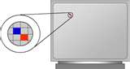


Deep learning intuition
Pixels
?
Edges
Object parts
(combinations of edges)
Faces
(combinations of parts)

Slide 8
Representation learning
Each level is an abstraction
Abstractions at one level are various ways to correlate lower-level abstractions
We can construct optimal abstractions by discriminating the important variations
Idea is that if we can deconstruct an object and then reconstruct it from fewer parts, we are learning its structure
Knowing the higher levels allow us to re-generate from such networks.
Pixels
?
Edges
Object parts
(combinations of edges)
Faces
(combinations of parts)

Slide 9
Deep learning intuition
Shared « edges » layer (cf. unsupervised learning)
Note: Sparsity important for these results.

Slide 10
Divide and conquer multilayer learn
Re-representing the data: Can we learn each transform separately ?
We pass a transformed version of the data to the next learner.
Learning our net one layer at a time
Starting at the bottom,
Guarantee that each layer improves ?
Need to know higher layers to learn lower layers?

Slide 11
Auto-encoders

Slide 12
Auto-encoders

Slide 13
Auto-encoders
? Problem ?

Slide 14
Sparse auto-encoders

Slide 15
Denoising auto-encoders

Slide 16
Stacked auto-encoders
Learned « features detectors »
Input patterns

Slide 17
Stacked auto-encoders
Input patterns

Slide 18
Networks as space transform
Take the generalized transform equation
… in its simplest form

Slide 19
Networks as space transform
Take the generalized transform equation
… in its simplest form

Slide 20
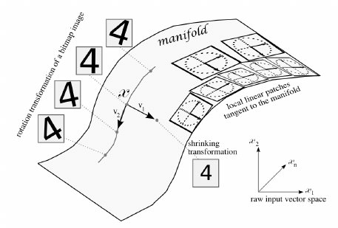
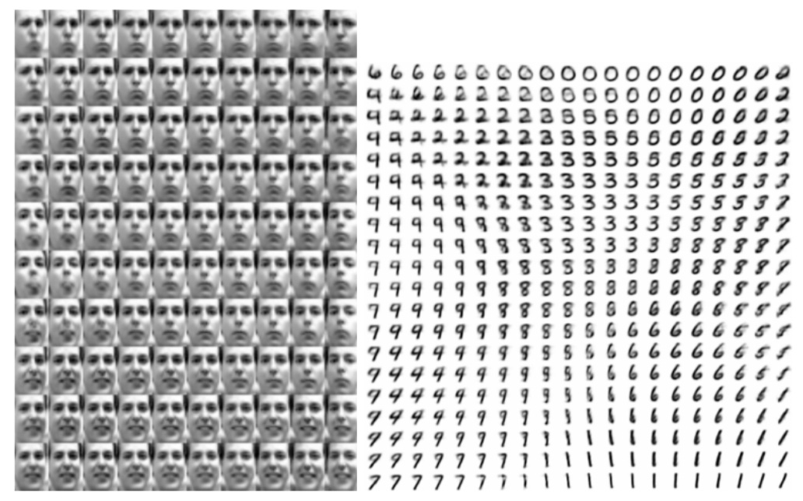
Manifold hypothesis
Real-world high dimensional data lie on low-dimensional manifolds embedded in the high-dimensional space.
Very relevant to our creative problem

Slide 21
Manifold hypothesis
emotion
orientation

Slide 22
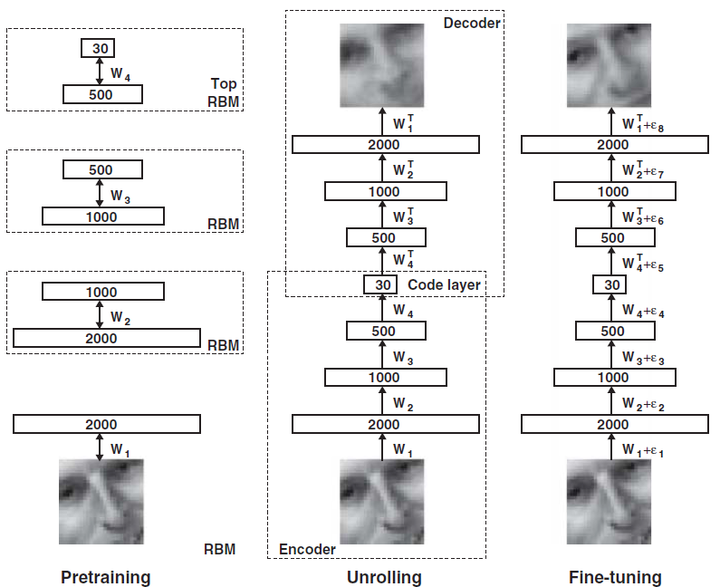
Pretrain, fine-tune (autoencoder)

Slide 23


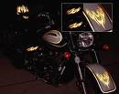

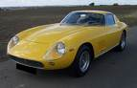
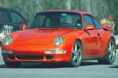

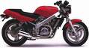

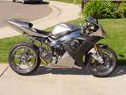

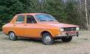
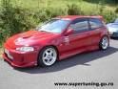
Supervised learning
Cars
Motorcycles
Testing:
What is this?

Slide 24



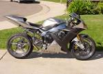


Semi-supervised learning
Unlabeled images (all cars/motorcycles)
Testing:
What is this?
Car
Motorcycle

Slide 25
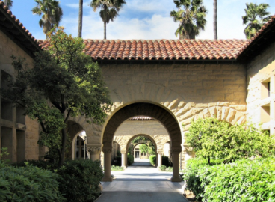
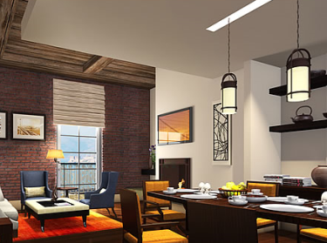
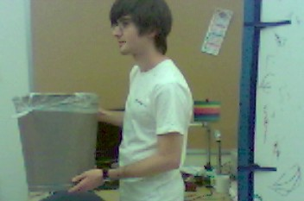
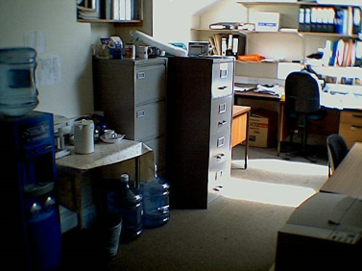
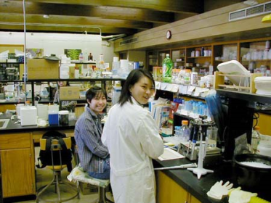
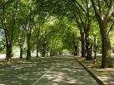
Self-taught learning
Transfer Learning
If your labeled dataset is small, can give a huge performance boost
Unlabeled images (random internet images)
Testing:
What is this?
Car
Motorcycle

Slide 26
Deep learning intuition
Note: Sparsity important for these results.
Shared « edges » layer (cf. unsupervised learning)

Slide 27
Deep autoencoder
28x28
Looks like a really nice way to do non-linear dimensionality reduction:
But it is very difficult to optimize deep autoencoders using backpropagation.
We now have a much better way to optimize them:
First train a stack of AE
Then “unroll” them.
Then fine-tune with backprop.
1000 neurons
500 neurons
250 neurons
linear units
30
250 neurons
500 neurons
1000 neurons
28x28

Slide 28
Modern version …
That was true 5 years ago …
Now we are just back with …

Slide 29
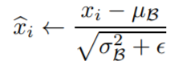
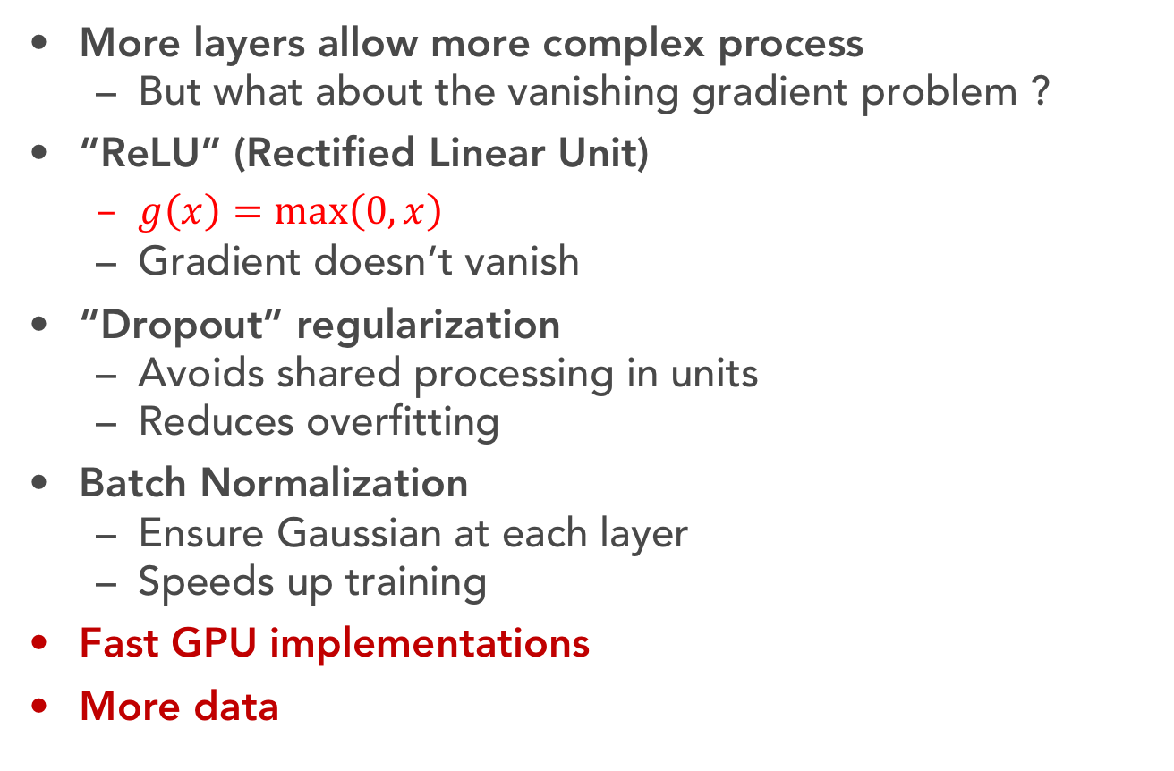
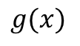
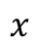
What has changed ?
More layers allow more complex process
But what about the vanishing gradient problem ?
“ReLU” (Rectified Linear Unit)
$g\left(x\right)=\max\left(0, x\right)$
Gradient doesn’t vanish
“Dropout” regularization
Avoids shared processing in units
Reduces overfitting
Batch Normalization
Ensure Gaussian at each layer
Speeds up training
Fast GPU implementations
More data
$$g(x)$$
$$x$$

Slide 30
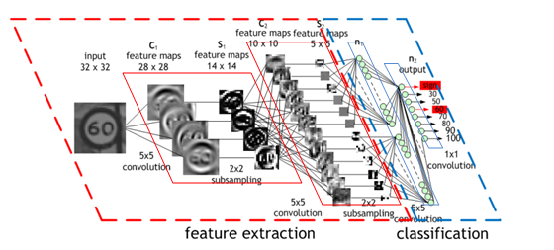
Convolutional Network
A special case of feed-forward multilayer neural network
The architecture can be deep or not, the term convolutional comes from
Individual neurons are tiled in such a way that they respond to overlapping regions

Slide 31

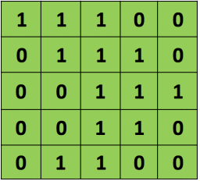
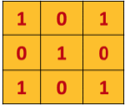
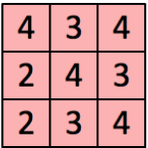
Convolutions ?

Slide 32


Convolution with padding
4x4 input. 3x3 filter. Stride = 1.
2x2 output.
5x5 input. 3x3 filter. Stride = 1.
5x5 output.

Slide 33
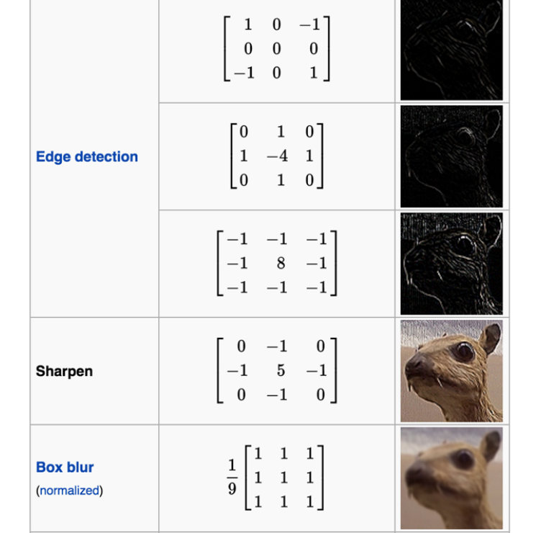
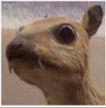
Filters examples
Original image

Slide 34
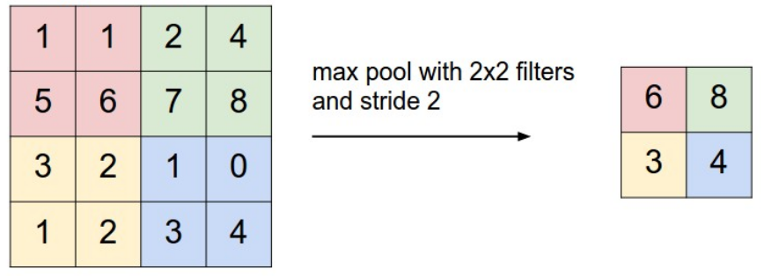
Pooling
Summarize the local information
Reduces dimensionnality
Different types (max, average, probabilistic)

Slide 35
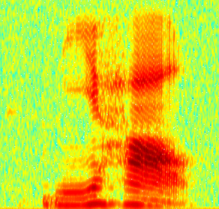
So how about music ?
The filters move in the frequency direction.
CNN
Frequency
Image
Time
Spectrogram

Slide 36
Music Machine Learning
XIII – Pytorch
Master ATIAM - Informatique
Philippe Esling (esling@ircam.fr)
Maître de conférences – UPMC
Equipe représentations musicales (IRCAM, Paris)

Slide 37



Deep learning frameworks
Modern tools for deep learning
Make it easy to implement neural networks
Often used components are ready-to-use
Linear, convolution, recurrent layers etc.
Many frameworks available:
Torch (2002), Theano (2011), Caffe (2014),
TensorFlow (2015), PyTorch (2016)
eras

Slide 38
Which framework to choose ?
Research, flexibility and being generally happy in life ?
Deployment (industrial, mobile, web)
Now integrated inside TensorFlow
eras

Slide 39
Which framework to choose ?
Deep learning research platform
Provides maximum flexibility and speed
Fast tensor computation (like numpy)
Strong GPU support
Dynamic graphs and automatic differentiation

Slide 40
Outline of the course
Basic concepts
Tensors, parameters, modules
Basic mathematics
Write a model
Using the simple nn layers
Defining your own modules
Mixing it up
Data and optimization
Writing your own dataloader
Optimizing the networks
Convolutional model

Slide 41
Basic concepts
torch.Tensor
similar to numpy.array
nn.Parameter
contain Parameters and define functions on input Variables
nn.Module
contain Parameters and define functions on input Variables
autograd.Variable
wraps a Tensor and enables auto differentiation
autograd.Function
operate on Variables, implements forward and backward

Slide 42
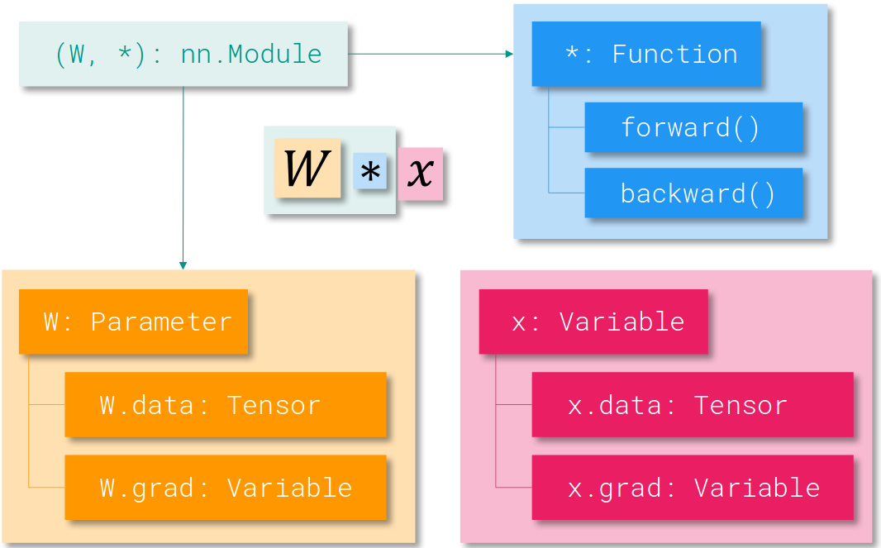
Basic concepts

Slide 43
Basic concepts
# IN PLACE ADD
y.add_(x)
print(y)
y = torch.rand(5, 3)
print(x + y)
print(torch.add(x, y))
import torch x = torch.rand(10, 5) y = torch.rand(10,5) z = x * y
import torch x = torch.ones(5,5) b = x.numpy()
import torch import numpy as np a = np.ones(5) x = torch.from_numpy(a)
import torch x= torch.rand(100,100) x = x.cuda()
One single operation to go to GPU computing ☺

Slide 44
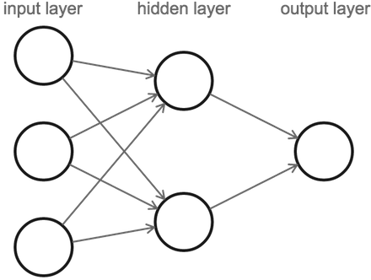
Creating a network (grandma way)
PyTorch allows to write models in one line
import torch.nn as nn
﻿model = nn.Sequential
(
nn.Linear(input_dim, hidden_dim),
nn.ReLU(True),
nn.Linear(hidden_dim, output_dim),
nn.Softmax()
)
x = torch.rand(16, input_dim)
model(x)
Low amount of control but easily implemented

Slide 45
Network definition
More flexible and controllable definition
Object-oriented through nn.Module
class TwoLayerNet(torch.nn.Module): def __init__(self, D_in, H, D_out): super(TwoLayerNet, self).__init__() self.linear1 = nn.Linear(D_in, H) self.linear2 = nn.Linear(H, D_out) self.relu = nn.ReLU(inplace=True) def forward(self, x): h_relu = self.linear1(x) h_relu = self.relu(h_relu) y_pred = self.linear2(h_relu)
ypred = nn.functional.softmax(y_pred) return y_pred
Operations can be layers
Or directly functions to apply
(when no parameters involved)

Slide 46
Exemple of a residual network
class ResBlock(nn.Module):
def __init__(self, dim, dim_res=32):
super().__init__()
self.block = nn.Sequential(
nn.Conv2d(dim, dim_res, 3, 1, 1),
nn.ReLU(True),
nn.Conv2d(dim_res, dim, 1),
nn.ReLU(True)
)
def forward(self, x):
return x + self.block(x)
Mixing modules and direct operations !
Modules are themselves usable in more complex models !
nn.Sequential(
ResBlock(64, 32),
ResBlock(64, 32),
)

Slide 47
Optimizing the network
# Have some data
N, D_in, H, D_out = 64, 1000, 100, 10
# Create a network model = TwoLayerNet(D_in, H, D_out)
# Select an adequate loss loss_fn = torch.nn.MSELoss(size_average=False)
# Create an optimizer (here stochastic gradient descent) optimizer = torch.optim.SGD(model.parameters(), lr=1e-4) for epoch in range(500): # Forward pass: Compute predicted y by passing x to the model y_pred = model(x); loss = loss_fn(y, y_pred) # Zero gradients (cumulative). optimizer.zero_grad()
# Backward pass: loss.backward()
# Apply your optimization (gradient descent)
optimizer.step()

Slide 48
Details on losses
A loss function takes a (output, target) pair of inputs,
Computes the prediction error made by the network
A simple loss: nn.MSELoss (mean-squared)
output = net(input)
target = torch.randn(10) # a dummy target, for example
criterion = nn.MSELoss()
loss = criterion(output, target)
print(loss)
Flashback time

Slide 49
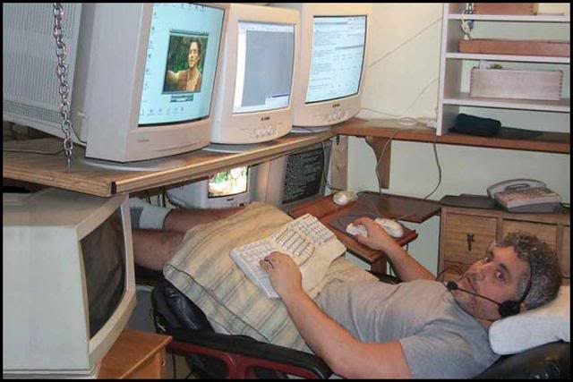
Network definition
THE REAL DEAL

Slide 50
Gradients
Variables wrap a tensor and saves a gradient history
Used for automatic differentiation
NOTE = Since Pytorch 0.4
All tensors are Variables
import torch from torch.autograd.variable import Variable x = Variable(torch.ones((2, 2)), requires_grad=True) y = x + 2 z = y * y * 3 out = z.mean() out.backward() print(x.grad)
This operation goes through the whole differentiation graph

Slide 51
Network definition
Affine transform
Implementing [Yang et. al 2016]
Attention layer on
1
Softmax
2
# Chord-level attention layer
class ChordLevelAttention(nn.Module):
def __init__(self, n_hidden):
super(ChordLevelAttention, self).__init__()
self.mlp = nn.Linear(n_hidden, n_hidden)
self.u_w = nn.Parameter(torch.rand(n_hidden))
def forward(self, X):
# get the hidden representation of the sequence
u_it = F.tanh(self.mlp(X))
# get attention weights for each timestep
alpha = F.softmax(torch.matmul(u_it, self.u_w), dim=1)
# get the weighted sum of the sequence
out = torch.sum(torch.matmul(alpha, X), dim=1)
return out, alpha
3
Trainable matrix
1
2
3
And Pytorch handles all derivations and gradients !

Slide 52
So what about data ?
Using torchvision extremely easy to load known datasets.
Example on MNIST (that we will use)
import torchvision
import torchvision.transforms as transforms
# Use transform to Tensors of normalized range [-1, 1].
transform = transforms.Compose(
[transforms.ToTensor(),
transforms.Normalize((0.5, 0.5, 0.5), (0.5, 0.5, 0.5))])
trainset = torchvision.datasets.MNIST(root='./data', train=True, download=True, transform=transform)
trainloader = torch.utils.data.DataLoader(trainset, batch_size=4, shuffle=True, num_workers=2)
for i, data in enumerate(trainloader, 0):
# get the inputs
inputs, labels = data

Slide 53
Writing your own dataset
﻿# Simplest Pytorch Audio dataset object ever
class AudioDataset(Dataset):
def __init__(self, datadir):
self.data_files = sorted(glob.glob(datadir + '/*'))
def __getitem__(self, idx):
try :
audio_file, sr = librosa.core.load(self.data_files[idx])
loaded_file = librosa.feature.melspectrogram(audio_file, sr)
loaded_file = torch.from_numpy(np.log1p(np.flipud(loaded_file)))
return loaded_file, 0
except :
return torch.Tensor(1), 0
def __len__(self):
return len(self.data_files)

Slide 54
Things to remember
Evaluate generalization on a separate test set
Beware of bad splits ! (cf. blue door / GTZAN)
Is your neural network a horse ? (Clever Hans)
Check your input data thoroughly (normalization !)
Address the characteristics of your data
Select your loss function accordingly
Always wonder about regularization
Dropout, BatchNorm, Augmentations
Start by solving simple toy problems
Good test = can you overfit on a small set ?

Slide 55
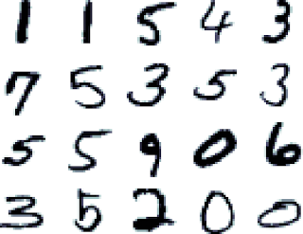
Classifying digits
Input Image
Conv 5x5, 1/10
MaxPool 2x2 + RELU
Conv 5x5, 10/20
MaxPool 2x2 + RELU
Conv 5x5, 10/20
Dropout , p = 0.5
Linear, 320/50
MNIST Dataset
Linear, 50/10
Softmax

Slide 56
Convolutional layers
kernel_size
Input
Output
out_channels x
kernel_size
in_channels
out_channels (equals the number of convolutional filters for this layer)
in_channels (e.g. 3 for RGB inputs)

Slide 57
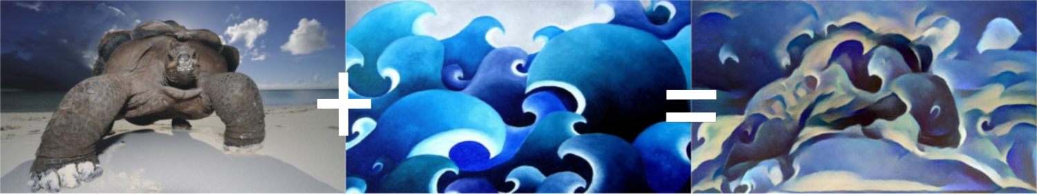
If you are bored ?
Perform some funky neural transfer with Pytorch
https://pytorch.org/tutorials/advanced/neural_style_tutorial.html

